Slide 1
Set Operations and Correlated Subqueries in SQL

Slide 2

Set Operations in SQL
SQL supports few Set operations which can be performed on the table data. These are used to get meaningful results from data stored in the table, under different special conditions.
UNION
UNION ALL
INTERSECT
MINUS
UNION Operation:
UNION is used to combine the results of two or more SELECT statements. However, it will eliminate duplicate rows from its result set. In case of union, number of columns and datatype must be same in both the tables, on which UNION operation is being applied.

Slide 3
Example
Table1 Table2
SELECT * FROM Table1 UNION SELECT * FROM Table2;
OUTPUT
ID | Name
1 | abhi
2 | adam
ID | Name
2 | adam
3 | Chester
ID | NAME
1 | abhi
2 | adam
3 | Chester

Slide 4

Union All
UNION ALL
This operation is similar to Union. But it also shows the duplicate rows.
SELECT * FROM Table1 UNION ALL SELECT * FROM Table2;
OUTPUT
ID | NAME
1 | abhi
2 | adam
2 | adam
3 | Chester

Slide 5

Intersection
Intersect operation is used to combine two SELECT statements, but it only retuns the records which are common from both SELECT statements. In case of Intersect the number of columns and datatype must be same.
SELECT * FROM Table1 INTERECT SELECT * FROM Table2;
OUTPUT
ID | NAME
2 | adam

Slide 6

Minus
The Minus operation combines results of two SELECT statements and return only those in the final result, which belongs to the first set of the result.
SELECT * FROM Table1 MINUS SELECT * FROM Table2;
OUTPUT
ID | NAME
1 | abhi

Slide 7
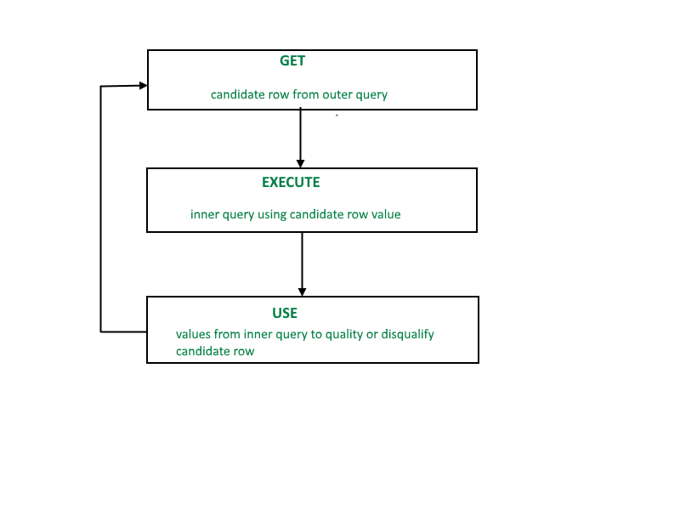
Correlated Subquery
Oracle performs a correlated sub-query when the sub-query references a column from a table referred in the parent statement. Each subquery is executed once for every row of the outer query.
A correlated subquery is evaluated once for each row processed by the parent statement. The parent statement can be a SELECT, UPDATE, or DELETE statement.
SELECT column1, column2, .... FROM table1 outer WHERE column1 operator (SELECT column1, column2 FROM table2 WHERE expr1 = outer.expr2);

Slide 8
Correlated Subquery
A correlated subquery is one way of reading every row in a table and comparing values in each row against related data. It is used whenever a subquery must return a different result or set of results for each candidate row considered by the main query. In other words, you can use a correlated subquery to answer a multipart question whose answer depends on the value in each row processed by the parent statement.
Nested Subqueries Versus Correlated Subqueries :
With a normal nested subquery, the inner SELECT query runs first and executes once, returning values to be used by the main query. A correlated subquery, however, executes once for each candidate row considered by the outer query. In other words, the inner query is driven by the outer query.
NOTE : You can also use the Exist, ANY and ALL operator in a correlated subquery.

Slide 9
The EXISTS Operator
Allows you to determine if the value in a correlated subquery exists. If exist, it returns true, else returns false.
Display those customer name from customer table whose customer id is found in the order table.
correlated subquery:
SELECT CustomerName
FROM Customers C
WHERE EXISTS
(SELECT * FROM ORDERS O
WHERE C.CustomerID=O.CustomerID);

Slide 10
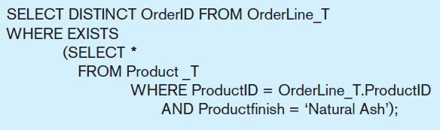
Correlated Subquery Example
Show all orders that include furniture finished in natural ash
The EXISTS operator will return a TRUE value if the subquery resulted in a non-empty set, otherwise it returns a FALSE
➔ A correlated subquery always refers to an attribute from a table referenced in the outer query
The subquery is testing for a value that comes from the outer query

Slide 11
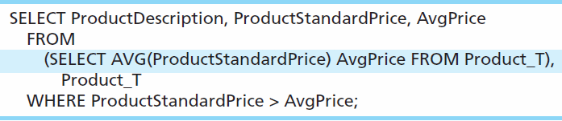
Another Subquery Example
Show all products whose standard price is higher than the average price
One column of the subquery is an aggregate function that has an alias name. That alias can then be referred to in the outer query
Subquery forms the derived table used in the FROM clause of the outer query
The WHERE clause normally cannot include aggregate functions, but because the aggregate is performed in the subquery its result can be used in the outer query’s WHERE clause

Slide 12
Examples
Find all the employees who earn more than the average salary in their department.
Find employees who have at least one person reporting to them.
Find the highest-paid employee of each department.
SELECT department_id, ename, salary from employees e WHERE salary = (SELECT max(salary) from employees WHERE department_id = e. department_id);
List the employee names whose salary is greater than the lowest salary of employee belonging to department number 20;
SELECT ename FROM emp WHERE sal>ANY (SELECT sal FROM emp WHERE deptno=20);
List the employee names whose salary is greater than the highest salary of all employees belonging to department number 20;
SELECT ename FROM emp WHERE sal> ALL (SELECT sal FROM emp WHERE deptno=20);
SELECT ename, salary, department_id FROM employees e WHERE salary > (SELECT AVG(salary) FROM employees WHERE department_id = e.department_id);
SELECT emp_id, ename, job_id, department_id FROM employees e WHERE EXISTS (SELECT emp_id FROM employees WHERE mgr_id = e.emp_id);

Slide 13
END

